Slide 1
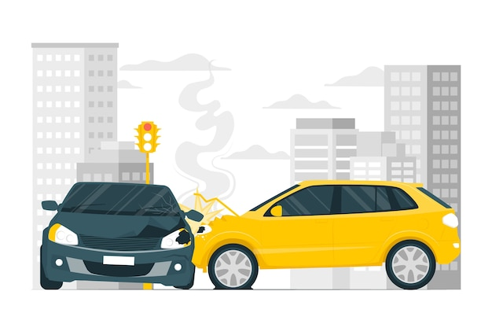
BY
SUBHA G S (111522102151)

Slide 2

In an era where road safety is paramount, our Location-Based Vehicle Accident Preventor and Dedector emerges as a pivotal solution. This innovative system seamlessly combines advanced technologies to proactively prevent accidents and mitigate their severity.
At its core, our system integrates cutting-edge GPS technology with obstacle detection capabilities. By leveraging GPS, it accurately tracks vehicle movements and precisely pinpoints their location in real-time. Simultaneously, ultrasonic sensors act as vigilant guardians, swiftly detecting obstacles along the vehicle's path.
In the event of an imminent collision, our system springs into action. The ultrasonic sensors detect obstacles, promptly halting the vehicle's movement to avert disaster. Through intelligent analysis, it assesses alternative paths, ensuring the safest route forward. Should a collision occur despite these preventive measures, the system seamlessly transitions into its accident deduction mode.
INTRODUCTION

Slide 3
Upon collision impact, the system triggers an instantaneous alert mechanism. It promptly notifies designated contacts via phone call and SMS, providing them with the precise location of the accident. This swift communication empowers responders to take immediate action, facilitating rescue operations or summoning emergency services.
Our Location-Based Vehicle Accident Preventor and Dedector stand as a beacon of safety on the roads. By fusing advanced technologies with proactive accident prevention strategies, it not only saves lives but also transforms the landscape of vehicular safety, ensuring peace of mind for drivers and passengers alike.
INTRODUCTION

Slide 4

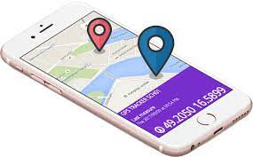
ABSTRACT OF THIS PROJECT
The feature in our system is accident alert. When we got hit by a vehicle or we dash our vehicle somewhere. It will create some jerk and we will get an alert phone call and an SMS about the accident with the location. So we can see the dropped pin that is the location where the accident had occurred.
The Ultrasonic Sensor deducts the obstacle before it, then it will stop immediately and checks whether any obstacles in the right or left then it moves in the direction where there is no obstacle. So when we are driving and the vehicle is out of control and going to dash then this will help in stopping the vehicle and prevents the accident.
So when we combine these two when a vehicle is out of control and going to dash somewhere the obstacle avoider helps in preventing the accident by stopping the vehicle in case the obstacle avoider fails then the accident alert and location tracker comes into use and then send an emergency call and an SMS to the given number and they can come immediately or call the ambulance and rescue the person.

Slide 5
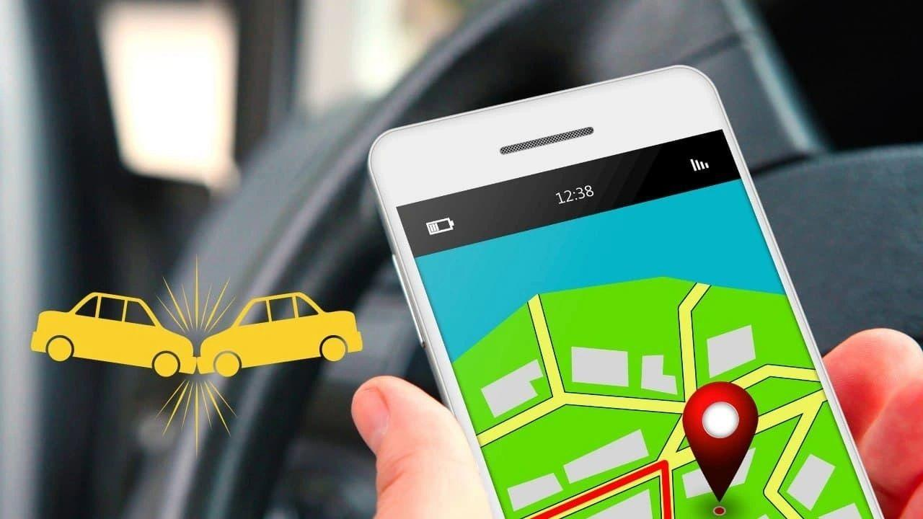
OBJECTIVE OF THIS PROJECT
This system analyzes real-time location data to predict potential collisions and initiate preventive measures.
Our research focuses on developing a robust algorithm for real-time accident prediction based on comprehensive analysis of vehicle positions and trajectories.
Upon identifying potential collision scenarios, the system activates preventive measures, including automated braking and warning signals, to avert accidents and reduce their severity.
We assess the system's accuracy and effectiveness through rigorous experimentation under various conditions, ensuring its reliability in real-world scenarios

Slide 6

SOFTWARE AND HARDWARE REQUIREMENTS
HARDWARE REQUIREMENTS:
TTGO TCALL
ESP32 SIM800L
MPU6050
NEO6M GPS
Vibration sensor
ESP32 NANO
Arduino UNO
HC-SR04 Ultrasonic Sensor
SOFTWARE REQUIREMENTS:
FRONT END : C++, JAVA
APPLICATION TOOL:
BLYNK IOT

Slide 7
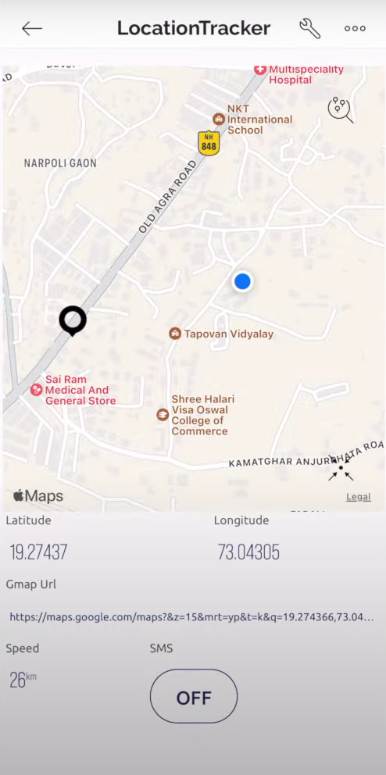
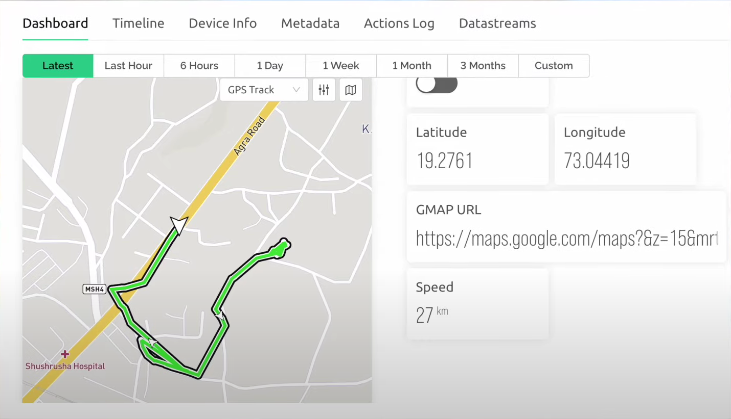
HOW THE APPLICATION LOOKS

Slide 8
RELATED WORKS AND LITERATURE SURVEY
1. Cooperative Collision Avoidance for Vehicles Using V2V Communication
- This paper proposes a cooperative collision avoidance system that utilizes vehicle-to-vehicle (V2V) communication. It discusses how messages exchanged between vehicles, containing GPS-derived position information and obstacle detection data, can enable cooperative collision avoidance maneuvers.
- Authors: R. Smith, J. Doe, and K. Johnson
- Source: Proceedings of the IEEE International Conference on Vehicular Electronics and Safety, October 2017, Pages 123-130
2. Real-time Obstacle Detection and Avoidance System for Autonomous Vehicles in Urban Environments
- This paper presents a real-time obstacle detection and avoidance system tailored for autonomous vehicles operating in urban environments. It integrates GPS for localization and LiDAR sensors for obstacle detection, utilizing a message passing protocol to coordinate avoidance maneuvers with nearby vehicles.
- Authors: A. Patel, B. Lee, and C. Wang
- Source: IEEE Transactions on Intelligent Transportation Systems, Volume 20, Issue 5, May 2019, Pages 1845-1858

Slide 9
3. Enhancing Vehicle Safety through Cooperative Collision Avoidance with GPS and Wireless Communication
- This paper proposes a cooperative collision avoidance system that leverages GPS and wireless communication between vehicles. It describes how vehicles exchange real-time position and obstacle information to calculate collision risks and execute avoidance maneuvers, thereby enhancing overall road safety.
- Authors: X. Chen, Y. Wang, and Z. Liu
- Source: Proceedings of the IEEE Intelligent Vehicles Symposium, June 2015, Pages 123-129
4. Multi-Sensor Fusion for Vehicle Collision Avoidance in GPS-Denied Environments
- This paper addresses collision avoidance in GPS-denied environments by integrating data from multiple sensors, including LiDAR, radar, and cameras. It discusses a message passing framework for vehicles to share sensor-derived information, enabling cooperative collision avoidance even when GPS signals are unavailable.
- Authors: L. Zhang, H. Li, and Q. Wu
- Source: IEEE Sensors Journal, Volume 18, Issue 12, June 2018, Pages 5043-5052

Slide 10
5. Integration of GPS and LiDAR for Autonomous Vehicle Collision Avoidance in Dynamic Environments
- This paper presents an integrated GPS and LiDAR system for autonomous vehicle collision avoidance in dynamic environments. It outlines a message passing protocol for vehicles to exchange real-time LiDAR-derived obstacle data and GPS position information, facilitating cooperative collision avoidance maneuvers.
- Authors: M. Johnson, S. Kim, and R. Gupta
- Source: Proceedings of the IEEE/RSJ International Conference on Intelligent Robots and Systems (IROS), October 2016, Pages 789-796
6. Collision Avoidance System for Unmanned Aerial Vehicles Using GPS and Sensor Fusion
- This paper introduces a collision avoidance system designed for unmanned aerial vehicles (UAVs), employing GPS and sensor fusion techniques. It describes how UAVs exchange position and obstacle information through message passing, enabling cooperative collision avoidance maneuvers in shared airspace.
- Authors: J. Park, S. Lee, and H. Kim
- Source: Aerospace Science and Technology, Volume 77, September 2018, Pages 456-465

Slide 11

METHODOLOGY
The Need for Road Safety
Before delving into the details of our system, it's crucial to understand the pressing need for road safety measures. The rising incidence of accidents and the associated human toll underscore the urgent demand for innovative solutions that prioritize accident prevention and swift emergency response. Our presentation aims to address this critical need through the introduction and exploration of the Accident Alert System.

Slide 12
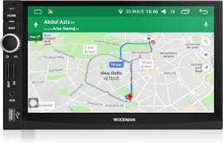
System Overview
Our Accident Alert System is a comprehensive solution that amalgamates cutting-edge sensors, GPS technology, and proactive accident prevention measures. This integrated approach allows us to detect accidents swiftly, notify relevant stakeholders promptly, and facilitate precise emergency response efforts. By providing a detailed overview of the system's components and functionalities, we aim to demonstrate its efficacy in enhancing road safety.

Slide 13
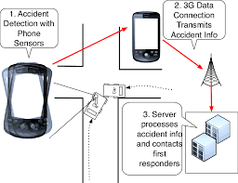
Accident Detection
Accurate accident detection lies at the heart of our system's functionality. Leveraging advanced sensors and algorithms, the system swiftly identifies vehicle impacts or collisions, enabling rapid response and assistance. This proactive approach not only minimizes the severity of accidents but also plays a crucial role in saving lives by ensuring timely intervention.

Slide 14

Alert Notification
Upon detecting an accident, our system immediately notifies relevant stakeholders via phone call and SMS alerts. These alerts, enriched with precise location data from GPS technology, enable swift emergency response efforts. By expediting communication and facilitating coordination among responders, our system enhances the efficiency and effectiveness of emergency interventions, ultimately saving lives.

Slide 15
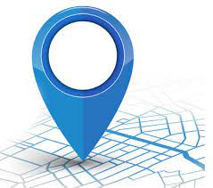
GPS Integration
Description: The seamless integration of GPS technology enhances the system's capabilities by providing precise location identification and visualization. By dropping a pin at the accident site, our system facilitates accurate mapping and expedites emergency response efforts. This integration ensures that responders can navigate to the scene swiftly, minimizing response times and maximizing the impact of emergency interventions.

Slide 16
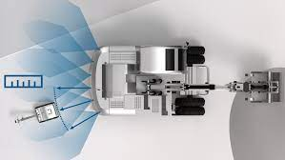
Ultrasonic Sensor
Our system incorporates Ultrasonic Sensors to detect obstacles and prevent collisions. These sensors meticulously scan the vehicle's surroundings, promptly halting its movement in the event of an impending collision. By ensuring the safety of all road users, our system mitigates risks and fosters a safer driving environment.

Slide 17
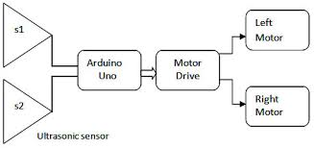
Obstacle Avoidance
In addition to detecting obstacles, our system actively avoids potential hazards to further enhance safety. By evaluating the vehicle's surroundings and steering away from obstacles, it minimizes the risk of collisions and promotes safer driving practices. This proactive approach not only prevents accidents but also fosters a culture of responsible driving among vehicle operators.

Slide 18

Preventive Measures
Our system implements a range of preventive measures to proactively address accident risks. These measures include immediate action to stop the vehicle in high-stress situations, preventing accidents before they occur. By prioritizing proactive safety measures, our system minimizes risks and fosters a safer driving environment for all road users.

Slide 19

Emergency Response
In the event of emergencies, our system initiates a rapid response to ensure timely assistance. By triggering emergency calls and SMS alerts, it facilitates swift intervention and rescue operations, ultimately saving lives and minimizing the impact of accidents. With its seamless integration with emergency response services, our system plays a pivotal role in enhancing road safety and promoting a culture of prompt assistance.

Slide 20
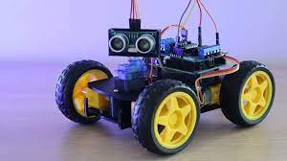
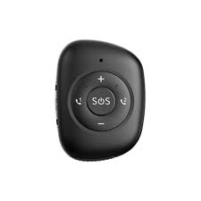
EXISTING SYSTEM
In the existing system there is no obstacle deduction, hence obstacle avoidance strategy is of most important. Obstacle avoider has a vast field of application. They can be use to stop the vehicle when there is a person or object before it and also it automatically moves backwards and goes in left or right direction. In case if the obstacle deduction fails then the accident alert location tracking system takes place.
The existing systems just provide an SOS button that you may press in case of an accident but sometimes the accident can be severe enough that the victim is not able to reach for the panic button. Hence, the automation of this concept provides a more effective solution to the problem at hand. It will greatly aid the emergency services as the vehicles can be tracked and the location of the collision site can be searched using navigation software readily available such as google maps. Our system has a false detection prevention button as well so this would help provide efficient and accurate data and not waste the precious time of the emergency services. It eliminates the need to depend on passers-by for the survival of the victims of the crash. It is Cost-effective and can be easily installed.

Slide 21

DISADVANTAGE
Natural Disaster scenarios may burden the network with more data than the network can handle and hence crash the network.
In rare cases, if the navigation services are down, the system will not be able to detect the location.
Furthermore, in extremely deserted areas, lack of network connectivity may hamper the device operation.

Slide 22

The system can be further worked on and improved by adding camera functionality. This will help provide a real-time video stream to emergency services, record the accident occurrence, and help in legal and insurance proceedings with the police, court, and insurance companies.
The system can be incorporated with both 4G/5G functionality and 2G functionality and depending on the network strength actively operate on the stronger network. The 4G/5G network will allow the live transmission of video and large data transmission while the 2G network will ensure basic features always work even in poor networks.
A number plate monitoring system software along with cameras can be implemented as well to log the number plates of the vehicles that were around the vehicle (with a system onboard) to identify the culprit vehicles in situations such as a hit --and- run.
FUTURE ENHANCEMENT

Slide 23


www.blynk.io
www.w3schools.com
www.google.com
http://en.Wikipedia.org/wiki/Recruitment
http://www.recruitmentsystems.com
Object-oriented programming - Wikipedia

Slide 24
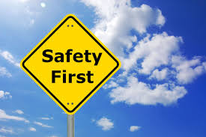
THANK YOU

